Slide 1


Slide 2

Microsoft
.NET Framework
Overview
B.R.S.N College

Slide 3














.NET Enterprise Vision
Users
Any device,
Any place,
Any time
XML Web Services
Integrate business applications and processes
Scheduling
Authentication
Notification
Back Office
Heterogeneous application and server infrastructure
Customer
Service
Sales
ERP & Billing

Slide 4
So what is .NET?
.NET is a platform that provides a standardized set of services.
  It’s just like Windows, except distributed over the Internet.
  It exports a common interface so that it’s programs can be run on any system that supports .NET.
A specific software framework
  Includes a common runtime

Slide 5
.NET Framework
Programming model for .NET
Platform for running .NET managed code in a virtual machine
Provides a very good environment to develop networked applications and Web Services
Provides programming API and unified language-independent development framework

Slide 6
The Core of .NET Framework: FCL & CLR
Common Language Runtime
  Garbage collection
  Language integration
  Multiple versioning support (no more DLL hell!)
  Integrated security
Framework Class Library
  Provides the core functionality:
  ASP.NET, Web Services, ADO.NET, Windows Forms, IO, XML, etc.

Slide 7
.NET Framework
Common Language Runtime
  CLR manages code execution at runtime
  Memory management, thread management, etc.
Common Language Runtime
Operating System

Slide 8
.NET Framework
Base Class Library
  Object-oriented collection of reusable types
  Collections, I/O, Strings, …
.NET Framework (Base Class Library)
Common Language Runtime
Operating System

Slide 9
.NET Framework
Data Access Layer
  Access relational databases
  Disconnected data model
  Work with XML
ADO .NET and XML
.NET Framework (Base Class Library)
Common Language Runtime
Operating System

Slide 10
.NET Framework
ASP.NET & Windows Forms
  Create application’s front-end – Web-based user interface, Windows GUI, Web services, …
ASP .NET
Web Forms Web Services
Mobile Internet Toolkit
Windows
Forms
ADO .NET and XML
.NET Framework (Base Class Library)
Common Language Runtime
Operating System

Slide 11
.NET Framework
Programming Languages
  Use your favorite language
C++
C#
VB.NET
Perl
J#
…
ASP .NET
Web Forms Web Services
Mobile Internet Toolkit
Windows
Forms
ADO .NET and XML
.NET Framework (Base Class Library)
Common Language Runtime
Operating System

Slide 12
.NET Framework
Common Language Specification
Common Language Specification
C++
C#
VB
Perl
J#
…
ASP .NET
Web Forms Web Services
Mobile Internet Toolkit
Windows
Forms
ADO .NET and XML
.NET Framework (Base Class Library)
Common Language Runtime
Operating System

Slide 13
.NET Framework
Visual Studio .NET
C++
C#
VB
Perl
J#
…
Visual Studio .NET
Common Language Specification
ASP .NET
Web Forms Web Services
Mobile Internet Toolkit
Windows
Forms
ADO .NET and XML
.NET Framework (Base Class Library)
Common Language Runtime
Operating System

Slide 14



.NET Framework
Standards Compliance
C# Language – Submitted to ECMA
C++
C#
VB
Perl
J#
…
Visual Studio .NET
Common Language Specification
Open Language
Specification
ASP .NET
Web Services Web Forms
Mobile Internet Toolkit
Windows
Forms
Web services –
XML, SOAP-based
ADO .NET and XML
.NET Framework (Base Class Library)
XML-based
data access
Common Language Runtime
Operating System
Notes:
Inside the .NET Framework
Standards Compliance
Microsoft .NET is built on standards. Both the Common Language Infrastructure, CLI and Visual C# have been submitted to the ECMA for approval and adoption. The data and Web services are built on XML and SOAP.
.Net Framework supports Web standards:
HTML- Hyper-Text Markup Language
XML - Extensible Markup Language, the universal format for structured documents and data on the Web.
WSDL- Web Services Description Language (WSDL)
SOAP - Simple Object Access Protocol, a simple, XML-based protocol for exchanging structured and type information on the Web. The protocol contains no application or transport semantics, which makes it highly modular and extensible. (SOAP currently still has no encryption support either)
XPATH - XML Path Language
XSLT - XSL Transformations (XSLT), is an XML-based language that enables you to transform one class of XML document to another.

Slide 15
Common Language Runtime
Manages running code – like a virtual machine
  Threading
  Memory management
  No interpreter: JIT-compiler produces native code – during the program installation or at run time
Fine-grained evidence-based security
  Code access security
    Code can be verified to guarantee type safety
    No unsafe casts, no un-initialized variables and no out-of-bounds array indexing
  Role-based security
Notes:
The Common Language Runtime
Features
The Common Language Runtime (CLR) is the execution engine for .NET Framework applications.
It provides a number of services including:
Code management (loading and execution)
Application memory isolation
Verification of type safety
Conversion of IL to native code
Access to metadata (enhanced type information)
Managing memory for managed objects
Enforcement of Code Access Security
Exception handling including cross-language exceptions
Interoperation between managed code, COM objects and pre-existing DLLs (unmanaged code and data)
Automation of object layout
Support for developer services (profiling, debugging, etc.)
Native Code is code compiled to processor-specific machine code.
Managed Code runs under a "contract of cooperation" with the CLR and it must supply the metadata necessary for the CLR to provide services such as memory management, cross-language integration, Code Access Security and automatic lifetime control of objects. All code based on Microsoft Intermediate Language (MSIL) executes as managed code.
Microsoft Intermediate Language (MSIL) is used as the output of a number of compilers and as the input to a Just-In-Time (JIT) compiler. The CLR includes several JIT compilers for converting MSIL to native code.

Slide 16
Managed Code
Code that targets the CLR is referred to as managed code
All managed code has the features of the CLR
  Object-oriented
  Type-safe
  Cross-language integration
  Cross language exception handling
  Multiple version support
Managed code is represented in special Intermediate Language (IL)

Slide 17
Automatic Memory Management
The CLR manages memory for managed code
  All allocations of objects and buffers made from a Managed Heap
  Unused objects and buffers are cleaned up automatically through Garbage Collection
Some of the worst bugs in software development are not possible with managed code
  Leaked memory or objects
  References to freed or non-existent objects
  Reading of uninitialised variables
Pointerless environment

Slide 18
Multiple Language Support
IL (MSIL or CIL) – Intermediate Language
  It is low-level (machine) language, like Assembler, but is Object-oriented
CTS is a rich type system built into the CLR
  Implements various types (int, float, string, …)
  And operations on those types
CLS is a set of specifications that all languages and libraries need to follow
  This will ensure interoperability between languages

Slide 19
Intermediate Language
.NET languages are compiled to an Intermediate Language (IL)
IL is also known as MSIL or CIL
CLR compiles IL in just-in-time (JIT) manner – each function is compiled just before execution
The JIT code stays in memory for subsequent calls
Recompilations of assemblies are also possible

Slide 20
Example of MSIL Code
.method private hidebysig static void Main() cil managed
{
.entrypoint
// Code size 11 (0xb)
.maxstack 8
IL_0000: ldstr "Hello, world!"
IL_0005: call void [mscorlib]System.Console::WriteLine(string)
IL_000a: ret
} // end of method HelloWorld::Main

Slide 21
Common Type System (CTS)
All .NET languages have the same primitive data types. An int in C# is the same as an int in VB.NET
When communicating between modules written in any .NET language, the types are guaranteed to be compatible on the binary level
Types can be:
  Value types – passed by value, stored in the stack
  Reference types – passed by reference, stored in the heap
Strings are a primitive data type now

Slide 22
Common Language Specification (CLS)
Any language that conforms to the CLS is a .NET language
A language that conforms to the CLS has the ability to take full advantage of the Framework Class Library (FCL)
CLS is standardized by ECMA

Slide 23
.NET Languages
Languages provided by Microsoft
  C++, C#, J#, VB.NET, JScript
Third-parties languages
  Perl, Python, Pascal, APL, COBOL, Eiffel, Haskell, ML, Oberon, Scheme, Smalltalk…
Advanced multi-language features
  Cross-language inheritance and exceptions handling
Object system is built in, not bolted on
  No additional rules or API to learn

Slide 24
C# Language
Mixture between C++, Java and Delphi
Component-oriented
  Properties, Methods, Events
  Attributes, XML documentation
  All in one place, no header files, IDL, etc.
  Can be embedded in ASP+ pages
Everything really is an object
  Primitive types aren’t magic
  Unified type system == Deep simplicity
  Improved extensibility and reusability

Slide 25
C# Language – Example
using System;
class HelloWorld
{
public static void main()
{
Console.WriteLine(“Hello, world!”);
}
}

Slide 26









Code Compilation and Execution
Compilation
Also called Assembly
(.EXE or
.DLL file)
Source Code
Language Compiler
Code
MSIL
Metadata
Before installation or the first time each method is called
Execution
Native
Code
JIT Compiler
Notes:
The Common Language Runtime
Compilation and Execution
The above diagram illustrates the process used to compile and execute managed code, or code that uses the CLR. Source code written in Visual C#, Visual Basic .NET or another language that targets the CLR is first transformed into MSIL by the appropriate language compiler. Before execution, this MSIL is compiled by the Just-in-Time (JIT) complier into native code for the processor on which the code will operate. The default is to JIT compile each method when it is first called, but it is also possible to “preJIT” MSIL code to native code at assembly install-time. With this option, all methods are compiled before the application is loaded so as to avoid the overhead of JIT compilation on each initial method call. You use the Native Image Generator (Ngen.exe) to create a native image from a managed assembly and install it into the native image cache. Once the code is compiled and cached, the CLR does not need to re-compile the MSIL code until the assembly is updated, the Just-In-Time compiled code is removed from the cache, or the machine is restarted.
All languages targeting the CLR *should* exhibit a similar performance. While some compilers may produce better MSIL code, large variations in execution speed are unlikely.

Slide 27
Assemblies
DLL or EXE file
Smallest deployable unit in the CLR
Have unique version number
No version conflicts (known as DLL hell)
Contains IL code to be executed
Security boundary – permissions are granted at the assembly level
Type boundary – all types include the assembly name they are a part of
Self-describing manifest – metadata that describes the types in the assembly

Slide 28
Metadata in Assembly
Type Descriptions
Classes
Base classes
Implemented interfaces
Data members
Methods
Assembly Description
Name
Version
Culture
Other assemblies
Security Permissions
Exported Types

Slide 29
Applications
One or more assemblies
Assemblies conflict resolution
  Using metadata
    Local (preferred)
    Global Assembly Cache (GAC)
Different applications may use different versions of an assembly
  Easier software updates
  Easier software removal

Slide 30
Visual Studio .NET
Development tool that contains a rich set of productivity and debugging features
  Supports managed and unmanaged applications
  Supports C#, C++, VB.NET, …
  Many useful tools and wizards
  Windows Forms Designer
  ASP.NET Web Forms Designer
  Web Services support
  SQL Server integration with ADO.NET and XML
VS.NET is not part of the .NET Framework
  Not necessary to build or run managed code
  The .NET Framework SDK includes command line compilers

Slide 31
VS.NET – Single Development Environment & Skill Set
From Visual Studio.NET you can:
  Write code
  Design user interface
  Study documentation
  Debug
  Test
  Deploy
Same tools for all languages
Same tools for all platforms

Slide 32
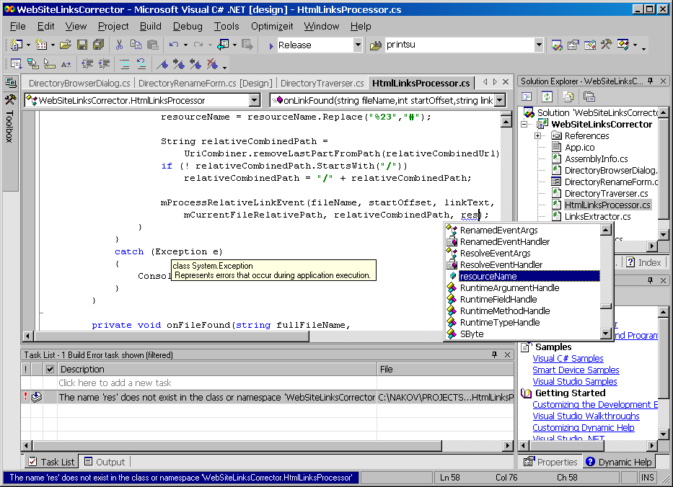
Visual Studio .NET

Slide 33
The .NET Framework Library
Web Forms Web Services
Mobile Internet Toolkit
Windows
Forms
ASP.NET
ADO.NET and XML
Base Class Library

Slide 34
.NET Framework Namespaces
System.Web
System.WinForms
Services
UI
Design
ComponentModel
Description
HtmlControls
Discovery
WebControls
Protocols
System.Drawing
Caching
Security
Drawing2D
Printing
Configuration
SessionState
Imaging
Text
System.Data
System.Xml
ADO
SQL
XSLT
Serialization
Design
SQLTypes
XPath
System
Collections
IO
Security
Runtime
Configuration
Net
ServiceProcess
InteropServices
Diagnostics
Reflection
Text
Remoting
Globalization
Resources
Threading
Serialization

Slide 35
Base Class Library Namespaces
System
Collections
Security
Configuration
ServiceProcess
Diagnostics
Text
Globalization
Threading
IO
Runtime
Net
InteropServices
Reflection
Remoting
Resources
Serialization
Notes:
First, let’s drill into the Base Framework.
The Base Framework is the most important part of the .NET Framework… primarily because it is the part that I worked on.
But seriously, the Base Framework is super important because no matter what kind of application you are building are using you’ll end up needing to use this functionality.
The system namespace contains all the base data types for the platform. Ints, floats, are defined here – arrays, strings, the root object and so forth.
Within that, we have a whole slew of various base services that are consistently available in the base platform.
Collections: growable arrays, hash table
IO: file, streams
NET: stuff that allows you to do tcpip, sockets

Slide 36
Base Class Library
Data types, conversions, formatting
Collections: ArrayList, Hashtable, etc.
Globalization: Cultures, sorting, etc.
I/O: Binary and text streams, files, etc.
Networking: HTTP, TCP/IP sockets, etc.
Reflection: Metadata and IL emit
Security: Permissions, cryptography
Text: Encodings, regular expressions

Slide 37
Data And XML Namespaces
System.Data
OleDb
SQLClient
Common
SQLTypes
System.Xml
XSLT
Serialization
XPath
Notes:
On top of the base classes we have the Data and Xml support. The ADO.NET supports both the tightly connected ADO style record set support that many applications use today as well as a new more loosely coupled model called that uses DataSets. This model allows for a more distributed nature style of programming that is becoming more common.
We also provide the SQLTypes namespace that provide datatypes that map directly onto the types that you're accustomed to when you do database programming, say in TSQL. Nullable datatypes. Things that can basically have an int value, or be NULL.
In the System.xml namespace we have all of the xml support. It truly is a world class set of functionality we’re providing here. There is of course a parser, and an xml writer – both of which are fully w3c compliant. There is a w3c dom implementation. On top of that there is an xslt for doing xsl transformations. We have an implementation of xpath that allows you to navigate data graphs in xml. And we have the serialization namespace that provides all of the core infrastructure for moving objects to xml representation and vice versa.

Slide 38
ADO.NET And XML
ADO.NET consumes all types of data
  XML (hierarchical), relational, etc.
Powerful in-memory data cache (DataSet)
  DataSet contains various data objects: tables, views, relations, constraints, etc.
  Lightweight, stateless, disconnected
  Supports both relational and XML access
High-performance, low overhead stream access
Great XML support including:
  W3C DOM, XSL/T, XPath, and Schema

Slide 39
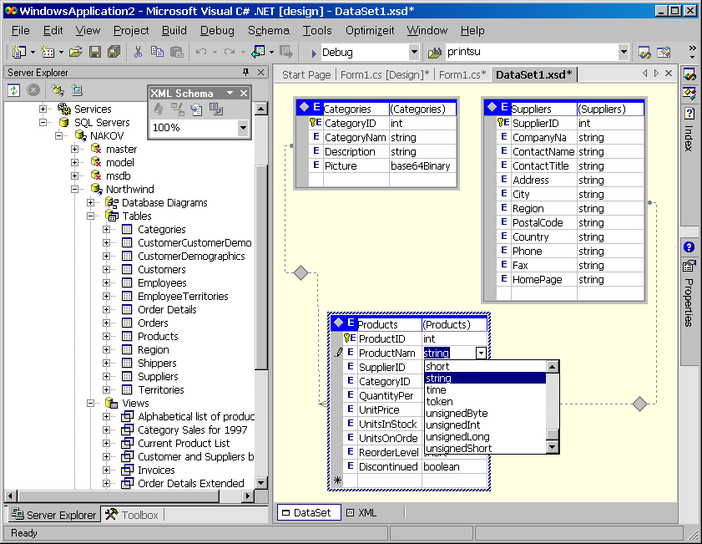
VS.NET – DataSet Designer

Slide 40
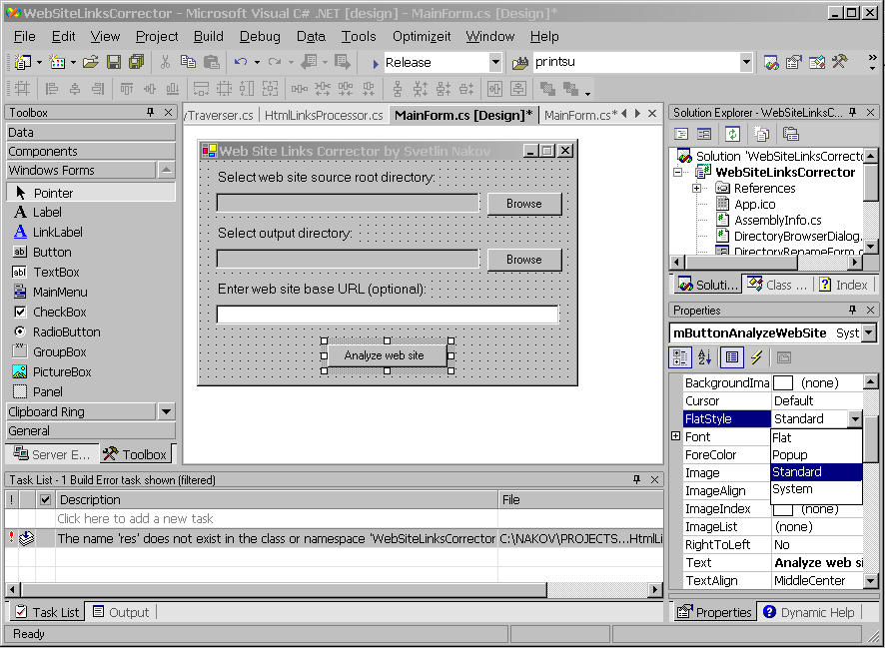
VS.NET – Windows Forms Designer

Slide 41
Demo
Create simple database application with:
  Windows Forms
  ADO.NET
  MS SQL Server
  Visual Studio .NET

Slide 42
ASP.NET Namespaces
System.Web
Services
UI
Description
HtmlControls
Discovery
WebControls
Protocols
Caching
Security
Configuration
SessionState
Notes:
For development of applications and services that run on the server, we have the ASP.NET architecture.
In System.Web.UI we have support for dynamically generating UI on the server and sending it down to clients. This is commonly in HTML, but it could also be in DHTML or even WAP for cell phones. The ASP.NET model allows you to build applications in much the same way you build client applications today: Just click and drag buttons and even higher level controls on a form. The infrastructure provides all the state management and other support.
In System.Web.Services you’ll find the infrastructure for building great Xml based web services. With this support you just write classes and methods and the infrastructure handles turning the calls into SOAP.
At the bottom you will find at the lower level things that are shared between web services and web ui: things like caching, configuration, security, state management and so forth.

Slide 43
ASP.NET
Framework for building Web applications and Web services in any .NET language
  C#, C++, VB.NET, JScript, etc.
Automatic multiple clients support
  DHTML, HTML 3.2, WML, small devices
Compilation of ASP.NET Web applications into .NET assemblies
  Cached the first time when called
  All subsequent calls use the cached version
Separation of code and content
  Developers and designers can work independently

Slide 44
ASP.NET
Rich page architecture – “Web Forms”
Rich set of ASP.NET server controls
  Data validation
  Data bound grids
Event-driven execution model
Great Web-services support
Easy to deploy
High reliability and availability
High performance and scalability
Scalable handling of state information

Slide 45
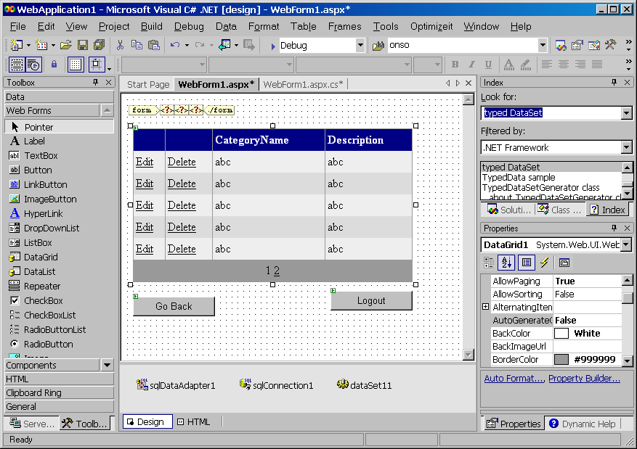
VS.NET – Web Forms Designer

Slide 46
Demo
Create simple Web-based database application with:
  ASP.NET (Web Forms)
  ADO.NET
  MS SQL Server
  Visual Studio .NET

Slide 47
Web Services
Technical definition – “A programmable application component accessible via standard Web protocols”
  Built on XML and SOAP
Expose functionality from Web Sites
  Almost like component programming over the Web
  Functionality exposed using XML/HTML
Standard Web Services include
  Calendar
  MSN Passport

Slide 48
XML Web Services Foundation
Simple, Open, Broad Industry Support
Open standards:
Publish, Find, Use Services: UDDI
Service Interactions: SOAP
Universal Data Format: XML
Ubiquitous Communications: Internet

Slide 49
ASP.NET Web Services
Simple programming model
  Author .ASMX files with class methods
  ASP.NET compiles on demand, generates WSDL contract, exposes HTML test page
Incoming HTTP/SOAP messages invoke methods
  No special HTTP, SOAP or XML knowledge required
Supports multiple message wire formats
  HTTP GET, POST, and SOAP Requests

Slide 50
Web Service Example in C#
ParcelTracker.asmx
<%@ WebService Language="C#" %>
using System;
using System.Web.Services;
public class ParcelTrackerWebService
{
[WebMethod]
public string GetOrderStatus(int orderNumber)
{
// Implementation here
}
}

Slide 51
.NET Framework on Linux
Mono Project
  Open Source C# compiler, CLR and Framework Class Library
  Runs on various platforms and hardware:
    Linux, Unix, FreeBSD, Windows – JIT-compiler for x86
    s390, SPARC, PowerPC – interpreter for these hardware architectures
  Supports also:
    ADO.NET and XML
    Windows Forms (not fully)
    ASP.NET
    Web Services

Slide 52
.NET Framework on Linux (2)
Mono Project
  Runs .NET portable executables on Linux, e.g.
      mono myapp.exe
  Compiles .NET applications to portable executables, e.g.
      mcs myapp.cs
  The obtained .exe file can taken and run on Windows
DotGNU Portable.NET
  Build and execute .NET applications on GNU/Linux, Windows, Solaris, NetBSD, FreeBSD, and MacOS X

Slide 53
Summary
.NET Framework is a code execution platform – the environment which .NET programs run
.NET Framework consists of two primary parts: Common Language Runtime and .NET Class Libraries
The CLS (Common Language Specification) allows different languages to interact seamlessly.
The CTS (Common Type System) allows all languages to share base data types.

Slide 54
Summary (2)
.NET languages are compiled to MSIL by their respective compilers
MSIL code is compiled to machine code by the JIT compiler
All .NET languages have equal access to the FCL (Framework Class Library) which is a rich set of classes for developing software
Base Class Library is set of basic classes: Collections, I/O, Networking, Security, etc.
ADO.NET provides .NET applications with access to relational databases

Slide 55
Summary (3)
.NET has great XML support including: DOM, XSLT, XPath, and XSchema
Windows Forms provides GUI interface for the .NET applications
ASP.NET allows creating web interface to .NET applications
Web Services expose functionality from web sites and make it remotely accessible through standard XML-based protocols
Visual Studio .NET is powerful development IDE for all .NET languages and technologies

Slide 56
.NET Framework – Resources
Visit following web sites:
  .NET Framework Home Site – http://msdn.microsoft.com/netframework/
  The Microsoft .NET Framework Community – http://www.gotdotnet.com/
  ASP.NET – http://www.asp.net/
  .NET Windows Forms – http://www.windowsforms.net/
  Code Project – http://www.codeproject.net/
  Mono – Open Source .NET Framework – http://www.go-mono.org/
  Rotor – Shared Source .NET CLI – http://msdn.microsoft.com/net/sscli/
Read the news groups:
  news://msnews.microsoft.com/microsoft.public.dotnet.framework

Slide 57
Questions?

